Slide 1

helping local day laborers
By Roman Rosales and Emmanuel Mendez Garcia

Slide 2
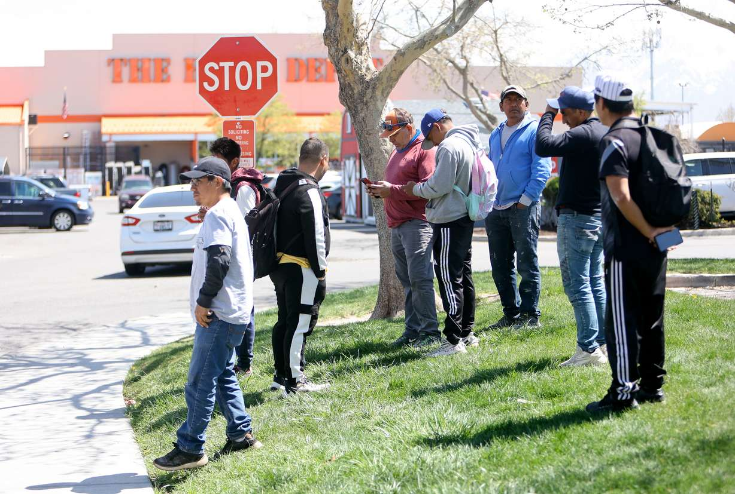

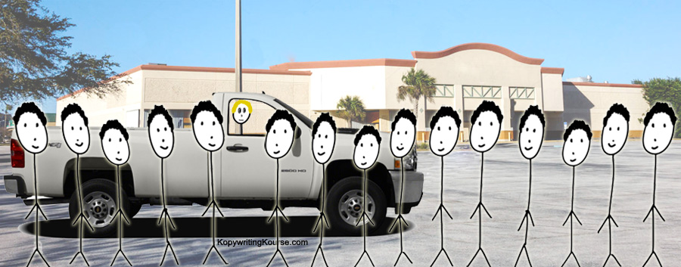
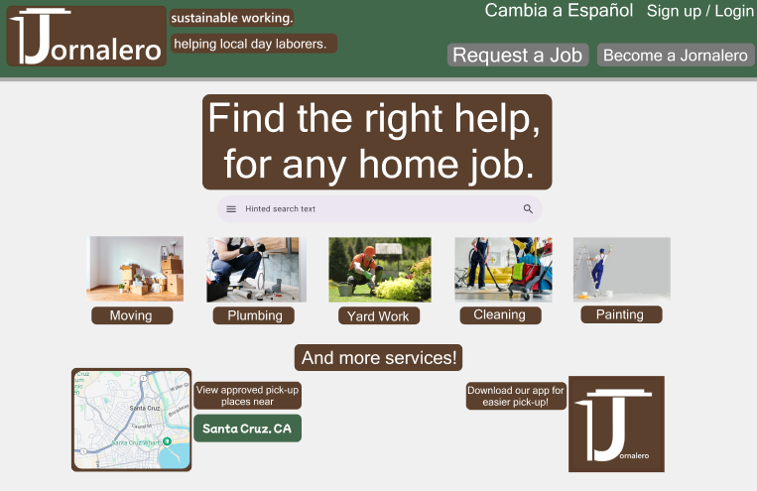

What is ?
The word Jornalero in old Spanish stands for day laborers, and for our project we wanted to create a platform which allows these often disenfranchised members of society, have a platform in which they can integrate more efficiently into the labor market while fulfilling a need for trustworthy handyman.
We are both hispanic-american, and we have noticed that often very talented workers in our community are relegated shadows of Home Depot parking lots, and we want them to being able to create a visible portfolio and have an opportunity to qualify for stable employment. This is also done while making a platform in which anyone would feel safe hiring them with appropriate checks on our platform. We've even integrated this concept into our logo, where the J is adorned with a straw hat and garden hoe.

Slide 3
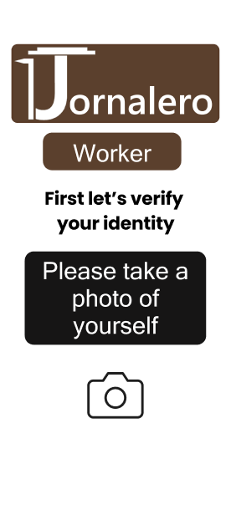
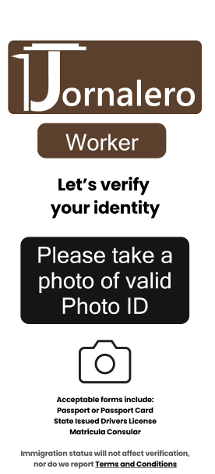
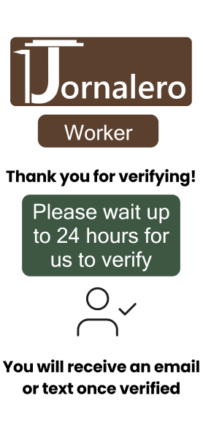

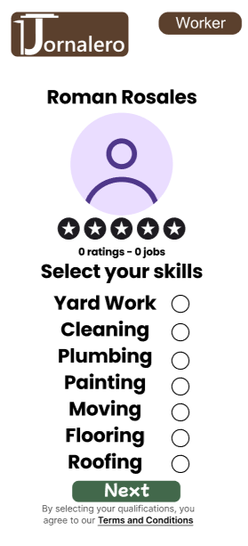
Jornalero for workers
Our platform connects day laborers who otherwise may just be standing in a Home Depot parking lot, to people who are looking for people to help them around the house in a safe and verified manner. On the website and app, we allow for people to find the right people for the job they need such as painting or gardening, and know upfront the quality of the work and asking rate immediately.
The platform will require every worker to verify their identity and pass a background check, and provide a photo of themselves. In addition to being able to hire someone on the website, we allow for you to hire any Jornalero person in person at our approved Jornalero meeting places (such as Home Depot or San Lorenzo lumber).
Verification can be done through a third party vendor such as Persona, like on Doordash.

Slide 4
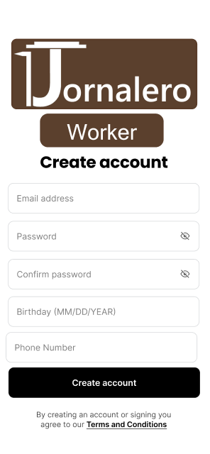
Jornalero for workers

Slide 5
Jornalero for workers

Slide 6
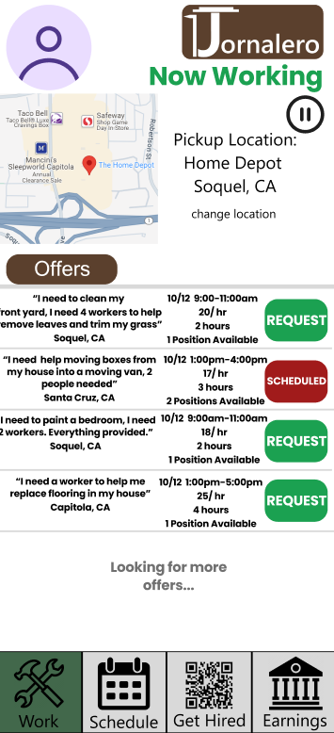
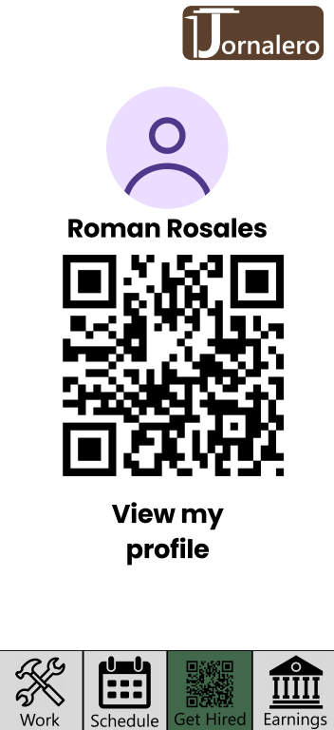
Jornalero for workers
Using our QR code feature in which with just the scan of a code you can see their profile and know whether this is someone you want to hire, or not. Every worker has the ability to create a portfolio where they can showcase their work, and have a rating, we hope that this can allow for our Jornaleros to create a verified portfolio which could contribute to them getting more stable employment in the future.

Slide 7
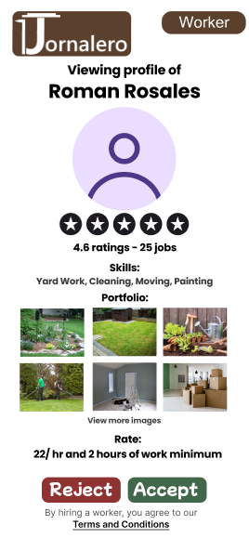
Jornalero for workers

Slide 8
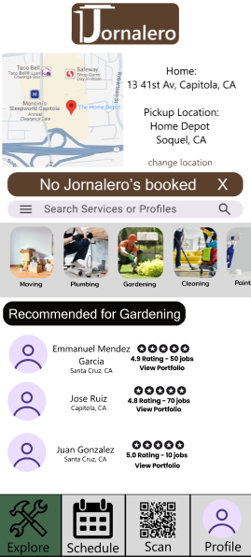
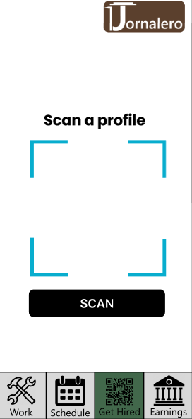
Jornalero for requesters

Slide 9
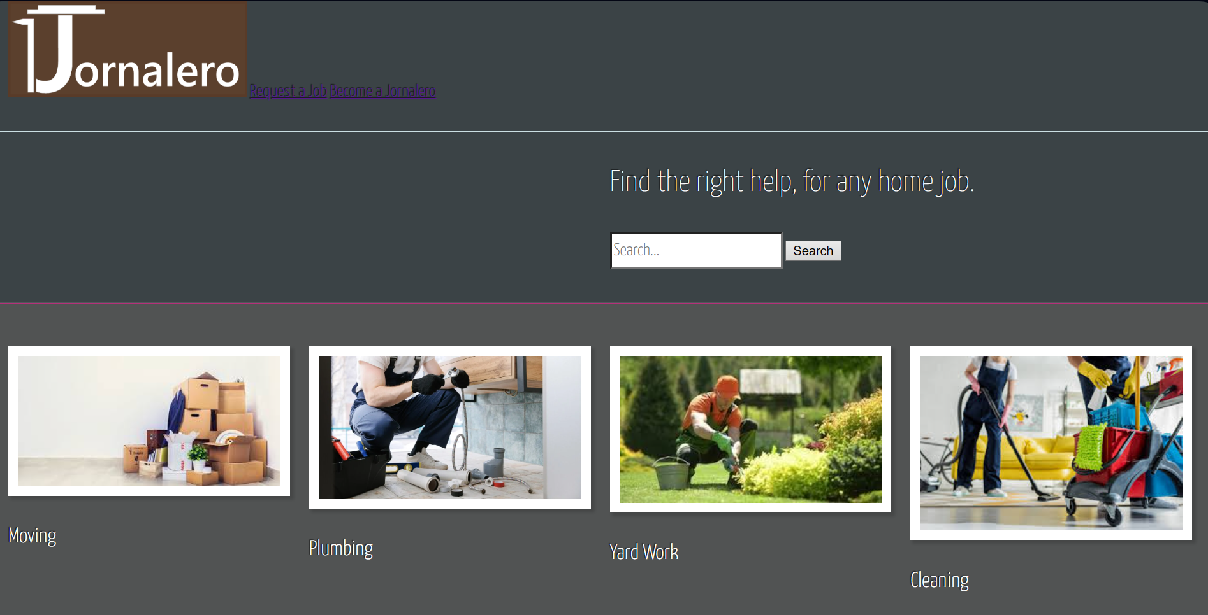
Jornalero Website
Unlike the app which is mostly conceptual, we created a website in ReactJS which shows how our site may look from the perspective of a computer user looking to hire people for help.
We are working on further improving our website.

Slide 10


What do we have Planned?
We would like to further develop the website so it is more functional, such as implementing APIs such as the Google Maps API, along with actually developing the app in an app developing environment like Kotlin since Android support would be crucial. In addition to this, we think it would be incredibly important to add in Spanish support.
Long term, it could be interesting to help other groups such as maids be able to find work in a similar manner on our platform.
With our platform, we want to give any disenfranchised worker a chance at a stable living.

